Slide 1
Introduction to Assembly

Slide 2
Languages
As you know, a programming language is a human readable language that is translated to machine language (a series of numbers).
Some languages are very human readable:
SELECT TOP 10 students FROM ualbany.students ORDER BY gpa

Slide 3
High Level Languages
Assembly Language
Very Human Readable
Can do a lot in one line
Very quick to write and debug
Program can be shorter
Great for enterprise software
Requires little change for CPU
Great deal of control
Very fast to execute
Requires little runtime support
Great for embedded/tiny systems

Slide 4
Refresher
C Compiler/ Linker
MyProgram.c
MyProgram
This is in Machine Language

Slide 5
Machine Language and Assembly are
Almost the Same!
Assembly language is a human readable translation of machine language
Assembly language directly translates, 1-1 with machine language
If they are the same, why have both?
add r1 r2 r3 ← this is human readable
11 23 ← this is CPU readable
For some CPU, those two are direct equivalents.

Slide 6
How does this relate to this class?
As we learn how a CPU works, we need to be aware of the external interface of the CPU – how the programmer sees the design.
Machine language (and therefore, the assembly language) are the interface that programmers have to the CPU.
Most programmers, of course, use C or something higher level to write their applications. But those use the assembly/machine language interface.

Slide 7
C Compiler/ Linker
MyProgram.c
MyProgram
(Compiled to ML)
OS
Schedules
Operating System
(Compiled to ML)
Runs
On
Runs
On
CPU

Slide 8
User initiates program load (double clicks application, for example)
Operating system reads program from disk into memory
Operating system marks this program in its own data structures as “runnable”
When a CPU needs work to do, the operating system points the CPU to the beginning of the program in memory
The CPU reads the first instruction from memory and starts running

Slide 9
Key Concepts
Instructions are simple to write and understand
You need more of them
Some of the things that you are used to have to be built yourself:
No loops, block-based flow control (if, switch)
Variables are different

Slide 10
Variables
In high level languages, when you see something like:
int a;
This means “allocate space and allow me to reference that space as a”
This could be on the stack or the heap (memory).
This is a high level abstraction that Assembly language typically doesn’t give us.

Slide 11
Registers
Each CPU has a small (8-16, typically) number of hardware “variables”. Inside the machine, these are numbered. In Assembly, you will see them, often, numbered the same way: R0 – R15, for example.
In x86/x64, you will see some registers with names (rax, rbx, rcx) and some numbered (r8 – r15).
You can use these registers in your programs as variables. Imagine if your C program had a global: int r0, r1,r2,r3,r4,r5,r6,r7;

Slide 12
Instruction format
Assembly looks a little different than C based languages. There are no line terminators (;), no curly braces ({}), no indentation. Usually everything is written in a straight line down the screen:
add R1,R2,R3
mult R7,R2,R6
branchifequal $1234
This is common across almost all assembly languages.

Slide 13
Addressing
You might have noticed $1234 on the previous slide.
Without blocks ({}), we need to have some way to indicate where to jump TO. In assembly, we indicate the address to jump to.
$1234 is an example of an absolute address – go exactly here.
branchifequal -100
branchifequal 124
These are examples of relative addressing – go 100 bytes backward and 124 bytes forward.

Slide 14
Labels
Some assemblers (a program to convert assembly language to machine language) have the ability to allow you to create labels. A label is a name for a line of code. The assembler will, as part of the assembling process, count the distance for you.
beginningOfLoop: add R1, R2, R3
…
branchifequal beginningOfLoop

Slide 15
A little practice
sub R0 R0 R0 – clear R0 (f)
sub R1 R1 R1 – clear R1 (c)
addimmediate 20 R1 – set c
sub R2 R2 R2 – clear R2
addimmediate 9 R2 – set R2 to 9
sub R3 R3 R3 – clear R3
addimmediate 5 R3 – set R3 to 5
multiply R2 R1 R4 -- 9*c into R4
divide R4 R3 R0 – 9*c/5 into R0(f)
addimmediate 32 R0 – complete
int f = 0;
int c = 20;
f = (9 * c)/5 + 32;

Slide 16
A little practice
sub R0 R0 R0 – clear R0 (sum)
sub R1 R1 R1 – clear R1 (max)
addimmediate 20 R1 – set max
sub R2 R2 R2 – clear R2 (a)
add R2 R0 R0 – sum += a
addimmediate 1 R2 – a++
branchifless R2 R1 -4 – for loop
int sum = 0;
for (int a=0;a<20;a++)
sum += a;

Slide 17
Calling functions
jump is like a “goto” in C or Java – it doesn’t handle parameters or returning. It is a one way trip.
Functions can be called in nearly all assembly languages.
For example:
call someFunction
someFunction: add R1 R2 R3
return

Slide 18
Function Parameters and Return Values
There are a few different mechanisms that can be used for parameters and return values.
One mechanism is to always use registers. R0 can be the first parameter, R1 the second, etc.
In this mechanism, R0 could always be the return value.

Slide 19
Why is that “bad”?
Each function could call any number of other functions. If function a calls function b which calls function c, what can the code that calls function a assume about the state of the registers? Maybe function b took 15 parameters. That means that code that makes a function call has to assume that the registers are not what they were when they called that function.
Sort of like lending your car to a friend – if you lend it with ½ a tank of gas, how much is in there when they return it?

Slide 20
A different approach
What if we all agree that R15 points to a stack of memory (in other words, the value stored in R15 is a pointer to memory). A caller could push parameters on the stack. The called function could do its work, then pop the parameters off the stack and push the return value then return. The caller could then pop the return value off of the stack and know (because everyone follows the rules) that the stack is what it was before we started.
Empty Stack
Param 3
Param 2
Param 1
Empty Stack
Return Value
Empty Stack
Call Function
Return
Before
start of call
Push parameters
on the stack
Pop parameters
from the stack
Push return value
on the stack
Pop return value
from the stack

Slide 21
Why is that bad?
Typically, as we will study later, accesses to memory are slow.
We are writing parameters to memory, then (nearly) immediately reading them back into registers.
There is clearly a tradeoff between flexibility (stack) and speed (registers). Can we do better than all-or-nothing?

Slide 22
A hybrid approach
What if we define the rules this way:
When calling a function, R0 and R1 hold the first two parameters.
All other parameters go on the stack and will be cleaned up.
Called functions can only use R0 or R1 (or save/restore other registers)
R0 will contain the return value.
This means that callers need only preserve/avoid 2 registers.
Is two the right number? Would 3 be better? Only experimentation will tell.

Slide 23
Back to variables
We can store integers, maybe floats and pointers in registers.
What do we do for strings? Arrays? Linked lists?
We store a pointer to an address in a register and use that as a base for referencing memory.
Where do we get the pointer? That depends…

Slide 24
Memory Maps
If there is no operating system running, you control the whole machine.
The hardware manufacturer should provide you with a memory map – a set of ranges that are available or not. For example:
ADDRESS RANGE NOTES
000000-03FFFF 256K Bytes of chip RAM
040000-07FFFF 256K bytes of chip RAM (option card)
080000-0FFFFF 512K Extended chip RAM (to 1 MB).
100000-1FFFFF Reserved. Do not use.
If this is the case, you can chose ANY address you want within the ranges specified.

Slide 25
Assembly with an operating system
If there is an operating system running, you follow the same rules as you would in, say, C.
On UNIX or OSX, you might call mmap or brk.
On Windows, you might call VirtualAlloc.
These functions typically return a pointer. You can then split the memory up any way that you choose. This is a theme in assembly – sometimes the freedom is overwhelming.

Slide 26
Converting assembly to machine language
Every assembly/machine language has a simple algorithm for conversion; assemblers aren’t typically complex software.
Typically, a number of instructions will all use a similar format. In the next few slides, we will look at some examples of MIPS assembly conversion.

Slide 27
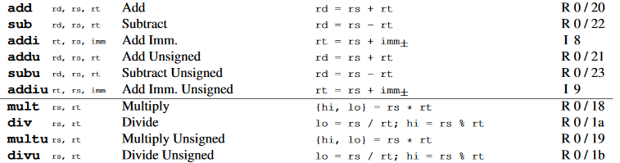

Instruction Format
Opcode
Function (as applies)

Slide 28
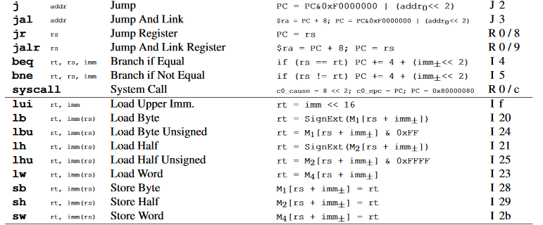
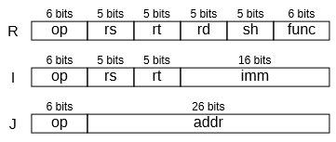

Slide 29
Addressing Modes
In RISC processors (reduced instruction set computers), memory is only accessed through a single set of simple instructions (like “load” and “store”).
In CISC processors (complex instruction set computers), memory can be accessed from (often) any instruction. This makes writing programs in assembly easier, but making the processor a little harder.

Slide 30
Some x86 addressing modes (an example)
movl 1, 0x123456 (moves 1 to the long word starting at hex 123456)
movl 1,(%rbx) (moves 1 to the address stored in register rbx)
movl 1,-12(%rbx) (moves 1 to the address in rbx minus 12)

Slide 31
Pros and Cons to this approach
With a RISC load/store approach, you have to load the value from memory into a register, then modify the value, then store it back to memory. Three instructions.
With a CISC approach, one instruction can alter a value in memory.
The work done by the CPU to modify the value is almost the same.
“Get me a soda” compared to “Go to the fridge. Get a soda. Bring it to me.”

